Slide 1

7th Grade Math
Unit 8, Lesson 6 Evaluating Numeric Expressions – Part 3 Volume 2, pg. 32

Slide 2


Benchmarks
MA.7.NSO.2.1
Solve mathematical problems using multi-step order of operations with rational numbers including grouping symbols, whole-number exponents, and absolute value.
MA.7.NSO.2.2
Add, subtract, multiply and divide rational numbers with procedural fluency.
volume 2, pg. 32

Slide 3
Integrated Mathematical Thinking and Reasoning Standards
MA.K12.MTR.1.1 Actively participate in effortful learning both individually and collectively.
MA.K12.MTR.2.1 Demonstrate understanding by representing problems in multiple ways.
MA.K12.MTR.3.1 Complete tasks with mathematical fluency.
MA.K12.MTR.4.1 Engage in discussions that reflect on the mathematical thinking of self and others.
MA.K12.MTR.5.1 Use patterns and structure to help understand and connect mathematical concepts.
volume 2, pg. 32

Slide 4

Learning Target
I can evaluate numeric expressions with up to six operations.
volume 2, pg. 32

Slide 5

Warm-Up
volume 2, pg. 32

Slide 6
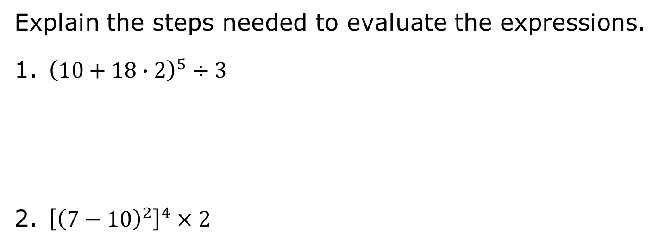
8.6.1 Warm-Up: Bell Work
Explain the steps needed to evaluate the expressions.
${\left(10+18∙2\right)}^{5}÷3$
${\left[{\left(7−10\right)}^{2}\right]}^{4}×2$
volume 2, pg. 32

Slide 7

Guided Instruction
volume 2, pg. 33

Slide 8
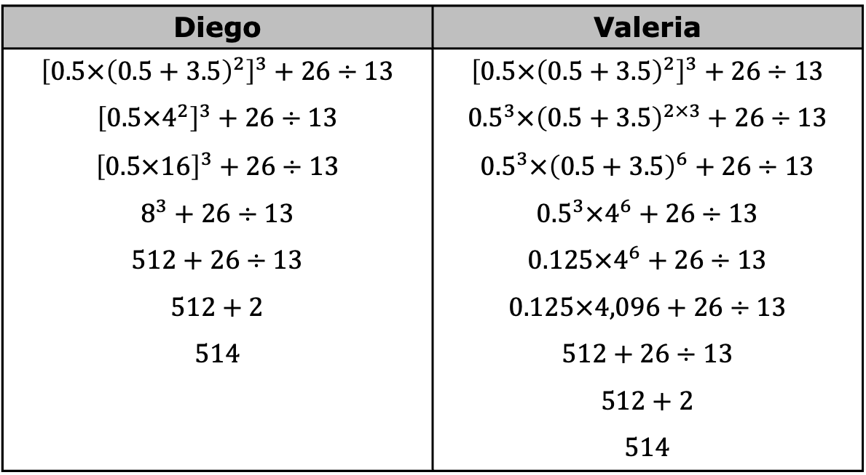
8.6.2 Guided Instruction: Evaluating Expressions with Multiple Steps
Two students evaluated the expression below in two different ways. Review the work of each student. Then, answer the questions.
Diego | Valeria
$${\left[0.5×{\left(0.5+3.5\right)}^{2}\right]}^{3}+26÷13$$ $${\left[0.5×4^{2}\right]}^{3}+26÷13$$ $${\left[0.5×16\right]}^{3}+26÷13$$ $$8^{3}+26÷13$$ $$512+26÷13$$ $$512+2$$ $$514$$ | $${\left[0.5×{\left(0.5+3.5\right)}^{2}\right]}^{3}+26÷13$$ $${0.5}^{3}×{\left(0.5+3.5\right)}^{2×3}+26÷13$$ $${0.5}^{3}×{\left(0.5+3.5\right)}^{6}+26÷13$$ $${0.5}^{3}×4^{6}+26÷13$$ $$0.125×4^{6}+26÷13$$ $$0.125×4,096+26÷13$$ $$512+26÷13$$ $$512+2$$ $$514$$
volume 2, pg. 33

Slide 9
How were Diego’s steps and Valeria’s steps different from each other?
Discuss with your partner whether you think one method was easier to use to evaluate the expression over the other.
volume 2, pg. 33

Slide 10

Activity
volume 2, pg. 33

Slide 11

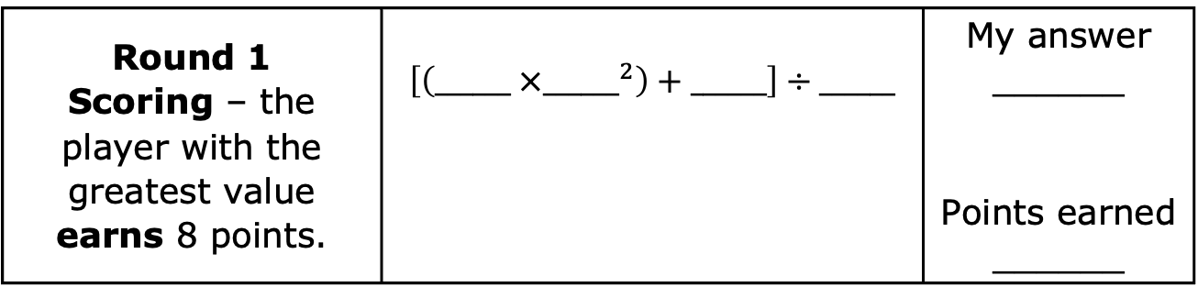
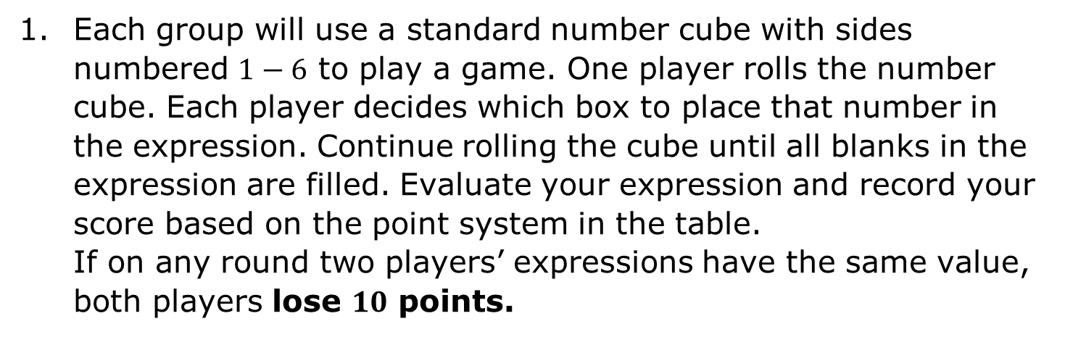
8.6.3 Activity: Expression Game
Each group will use a standard number cube with sides numbered $1−6$ to play a game. One player rolls the number cube. Each player decides which box to place that number in the expression. Continue rolling the cube until all blanks in the expression are filled. Evaluate your expression and record your score based on the point system in the table. If on any round two players’ expressions have the same value, both players lose $10$ points.
Round 1 Scoring – the player with the greatest value earns 8 points. | $$\left[\left(______ ×{______}^{2}\right)+______\right]÷______$$ | My answer ______ Points earned ______
volume 2, pg. 33

Slide 12
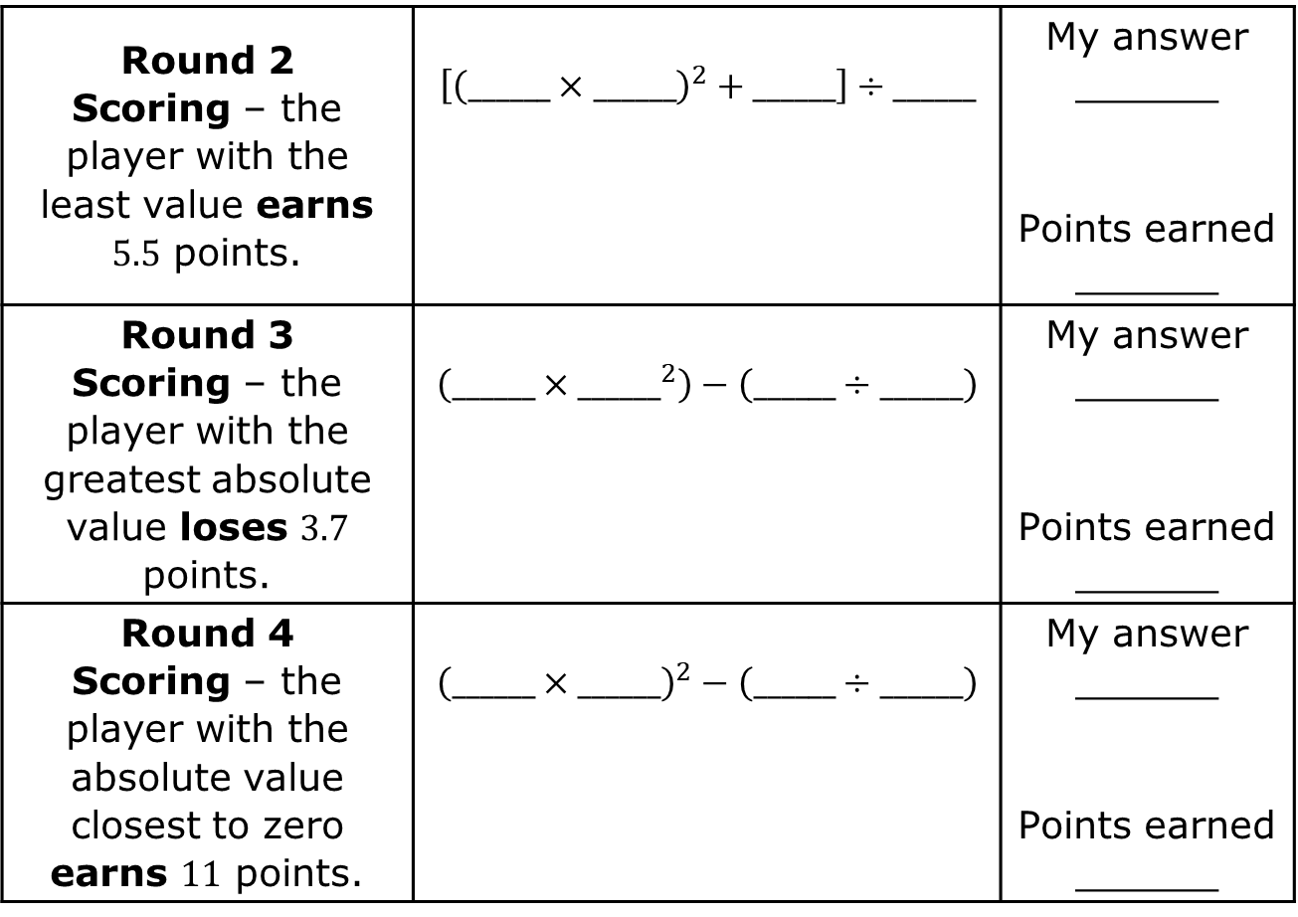
Round 2 Scoring – the player with the least value earns $5.5$ points. | $$\left[{\left(______×______\right)}^{2}+______\right]÷______$$ | My answer ______ Points earned ______
Round 3 Scoring – the player with the greatest absolute value loses $3.7$ points. | $$\left(______×{______}^{2}\right)−\left(______÷______\right)$$ | My answer ______ Points earned ______
Round 4 Scoring – the player with the absolute value closest to zero earns $11$ points. | $${\left(______×______\right)}^{2}−\left(______÷______\right)$$ | My answer ______ Points earned ______
volume 2, pg. 33

Slide 13
My Game Score
Round 1 | Round 2 | Round 3 | Round 4 | My Score
Discuss with the other players what strategies they used to determine where to put the numbers. Summarize your discussion.
volume 2, pg. 33

Slide 14

Try It
volume 2, pg. 34

Slide 15

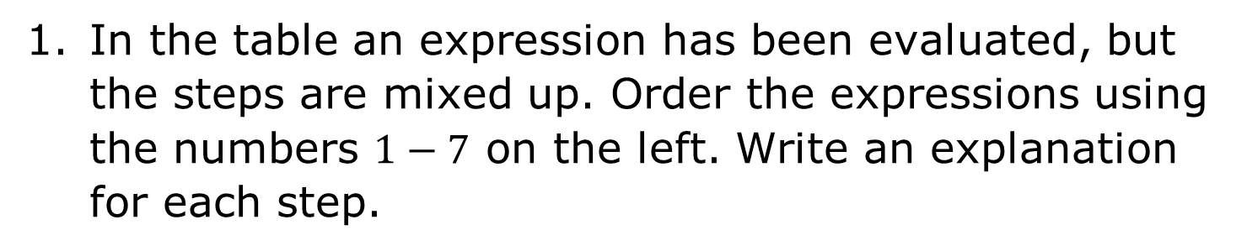
8.6.4 Try It: Evaluating Expressions with Multiple Steps
In the table an expression has been evaluated, but the steps are mixed up. Order the expressions using the numbers $1−7$ on the left. Write an explanation for each step.
volume 2, pg. 34

Slide 16
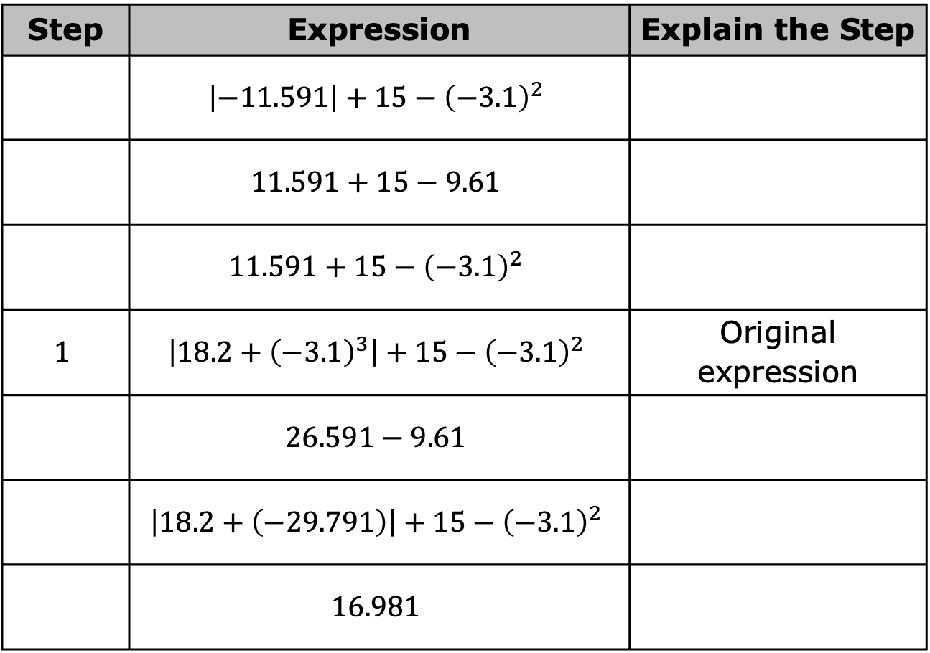
Step | Expression | Explain the Step
 | $$\left|−11.591\right|+15−{\left(−3.1\right)}^{2}$$
 | $$11.591+15−9.61$$
 | $$11.591+15−{\left(−3.1\right)}^{2}$$
$$1$$ | $$\left|18.2+{\left(−3.1\right)}^{3}\right|+15−{\left(−3.1\right)}^{2}$$ | Original expression
 | $$26.591−9.61$$
 | $$\left|18.2+\left(−29.791\right)\right|+15−{\left(−3.1\right)}^{2}$$
 | $$16.981$$
volume 2, pg. 34

Slide 17

Evaluate each expression without using a calculator.
${\left(\frac{3}{4}\right)}^{2}×32+3^{2}$
${\left[{\left(10+4.5\right)}^{2}−10.25\right]}^{2}÷40$
$6.7−{\left(2^{3}−3\right)}^{3}÷10+4$
volume 2, pg. 35

Slide 18
Activity
volume 2, pg. 35

Slide 19
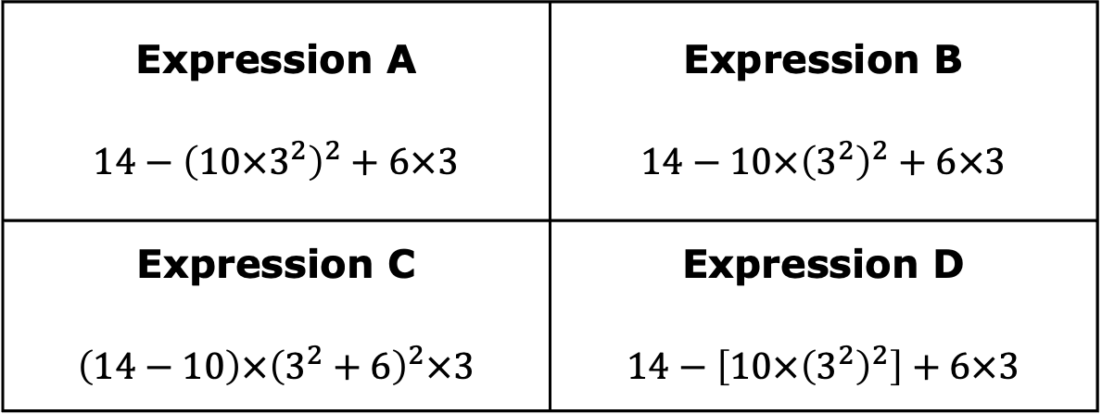
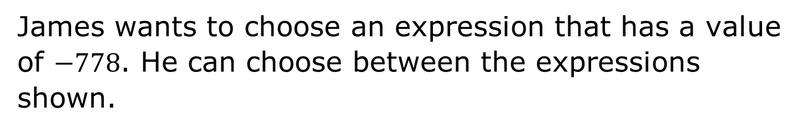
8.6.5 Activity: Class Debate
James wants to choose an expression that has a value of $−778$. He can choose between the expressions shown.
Expression A $$14−{\left(10×3^{2}\right)}^{2}+6×3$$ | Expression B $$14−10×{\left(3^{2}\right)}^{2}+6×3$$
Expression C $$\left(14−10\right)×{\left(3^{2}+6\right)}^{2}×3$$ | Expression D $$14−\left[10×{\left(3^{2}\right)}^{2}\right]+6×3$$
volume 2, pg. 35

Slide 20
Which expression should James choose? _________
Each corner of the room is labeled A, B, C, or D. After selecting the expression that you think James should choose, go to the corner of the room that matches the label for that expression.
With your classmates who selected the same expression, discuss why your expression is the expression that James should choose. Discuss why James should not choose the other expressions. One member of your group will act as a representative during a class debate.
For the debate, prepare an opening statement and potential rebuttals for arguments from other groups. Keep arguments and rebuttals centered on the mathematics.
After the debate, explain whether you would select the same expression again.
volume 2, pg. 35

Slide 21

Wrap-Up
volume 2, pg. 36

Slide 22
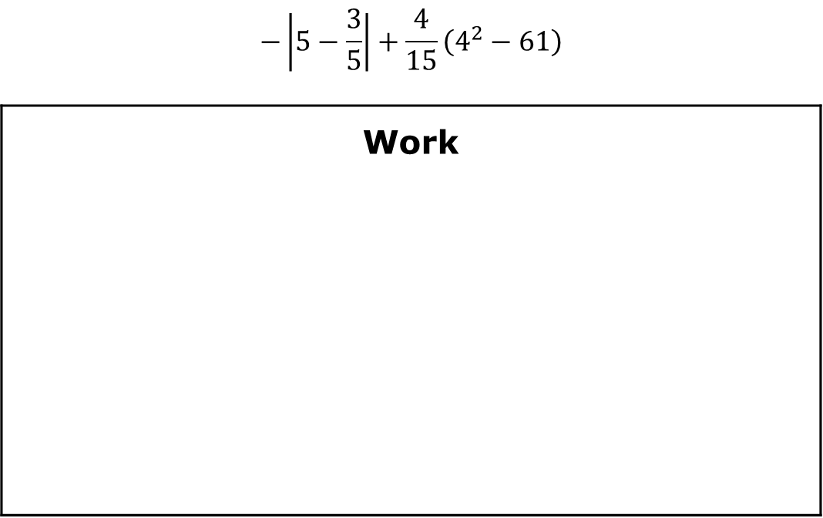
8.6.6 Wrap-Up: Ticket Out the Door
Evaluate each expression without a calculator. Show each step you use.
$$−\left|5−\frac{3}{5}\right|+\frac{4}{15}\left(4^{2}−61\right)$$
Work
volume 2, pg. 36

Slide 23
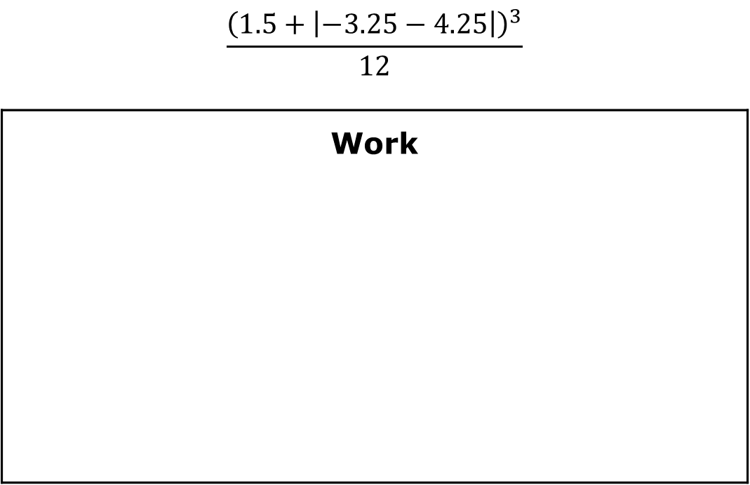
$$\frac{{\left(1.5+\left|−3.25−4.25\right|\right)}^{3}}{12}$$
Work
volume 2, pg. 36

